Slide 1

Eta Kappa Nu (HKN) Pledge Meeting Three
Spring 2015
11 March

Slide 2
Agenda
E-Week Results
Upcoming Events
Signature Party
Tech Core Night, Peer Advising Night
Firesides
Admitted Students Day
Sarah’s Mediterranean Grill
Advising and Games

Slide 3
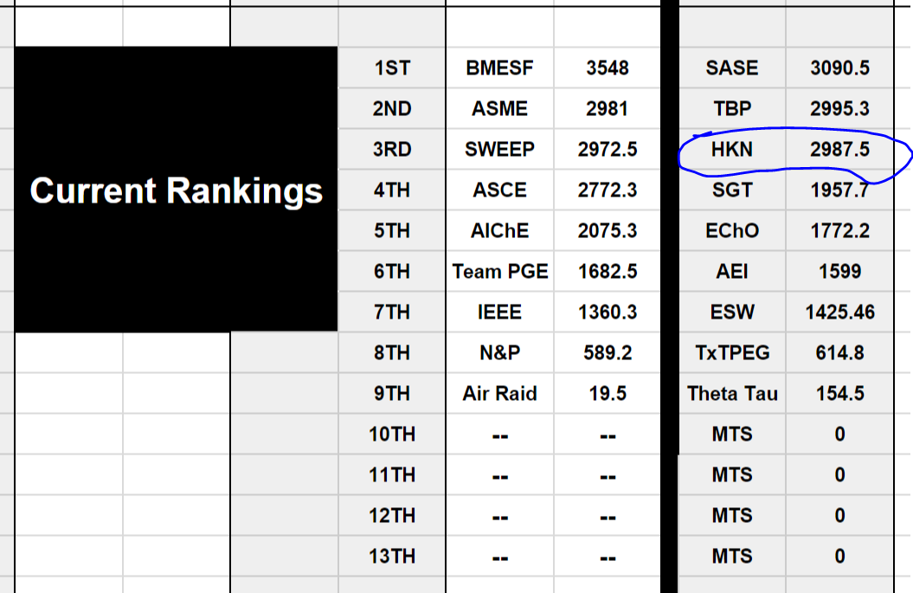
E-Week Results

Slide 4
Upcoming Events
Signature Party: Saturday, March 28, 7pm-9pm
Tech Core Night: Tuesday, March 31, 7pm-9pm
Peer Advising Night: Tuesday, April 14, 7pm-9pm
Firesides
Tewfik: Tuesday, March 24, 6pm
Caramanis: Monday, March 30, 7pm
Service Events
Yellow Bike: Fridays, 6pm-9pm
Capital Area Food Bank: Saturday, 1:30pm – 4:30pm
Lots of socials to come.

Slide 5
Admitted Students Day
Tomorrow! More volunteers needed!
Schedule of events:
10:00am: Welcome from Dr. Tewfik and Dr. Valvano
11:00am: Tour of the Texas Advanced Computing Center and the UT campus
12:00pm: Lunch and Learn with faculty
1:00pm: Student Panel

Slide 6

Sarah’s Mediterranean Grill

